Slide 1

Next Generation of Content Intelligence
Easier to setup, more flexible, reliable and powerful
Younes Regaieg
ECM Software Engineer @ XeniT Nv
@yregaieg
Francesco Corti
ECM and BI specialist
@FrkCorti

Slide 2

Outline
What is Alfresco Audit Analysis and Reporting (aka Alflytics)
How does all of that works
A brave new era, Welcome Alflytics 5.0 !
The new dockerized setup, how were the images built !
Start up Alflytics in 60 seconds !
Extracting the data from Alfresco
How does the bundled dashboards look like
How to use Pentaho Spoon for editing Jobs/transformations from the container
How to use Pentaho Report Designer for editing reports from the contrainer
How to play with OLAP cube structure for Saiku free analytics
Q&A

Slide 3
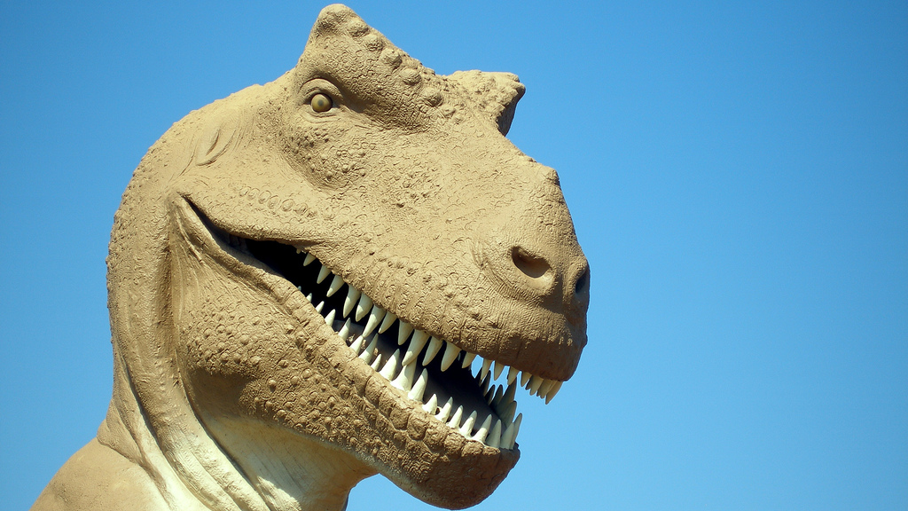

Back to the root

Slide 5
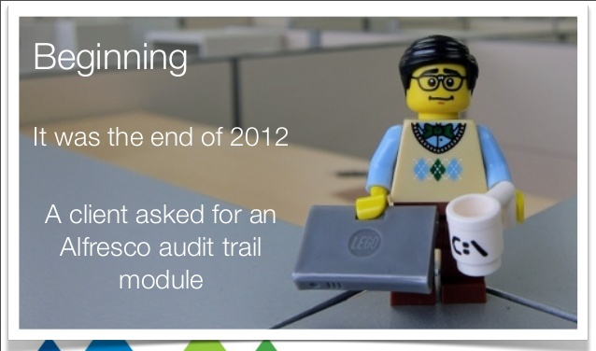

Slide 6
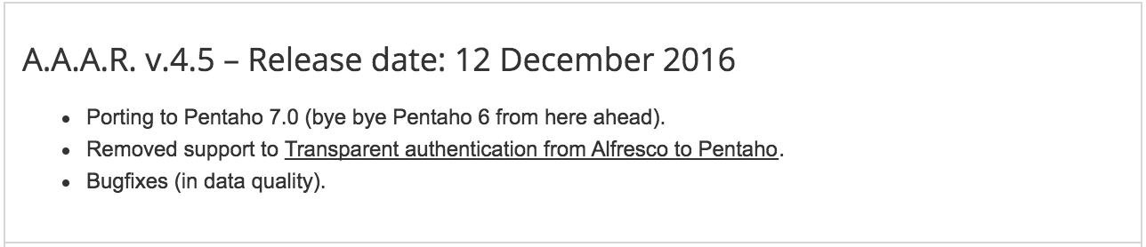
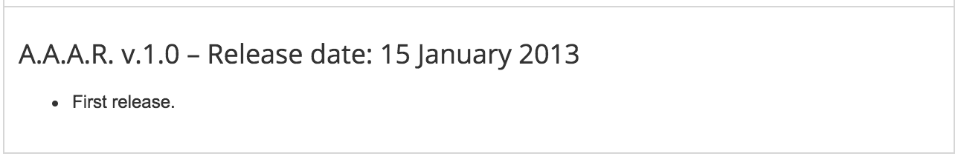
A new release each 4-6 months

Slide 7
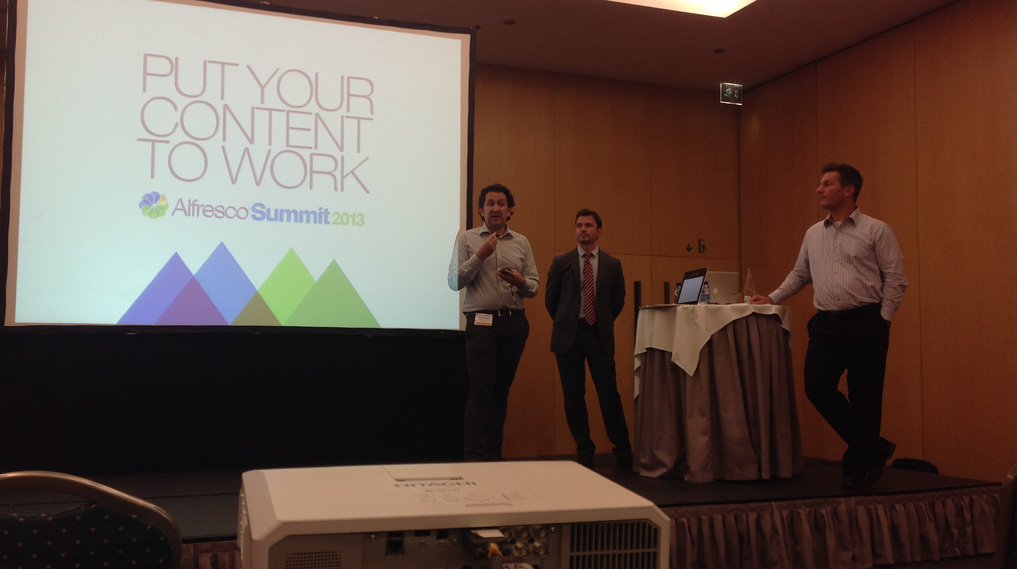
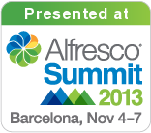

Slide 8
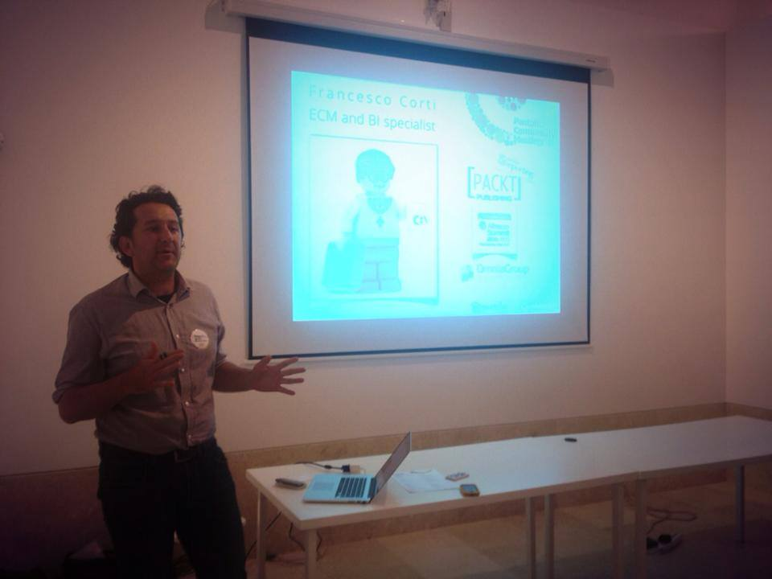
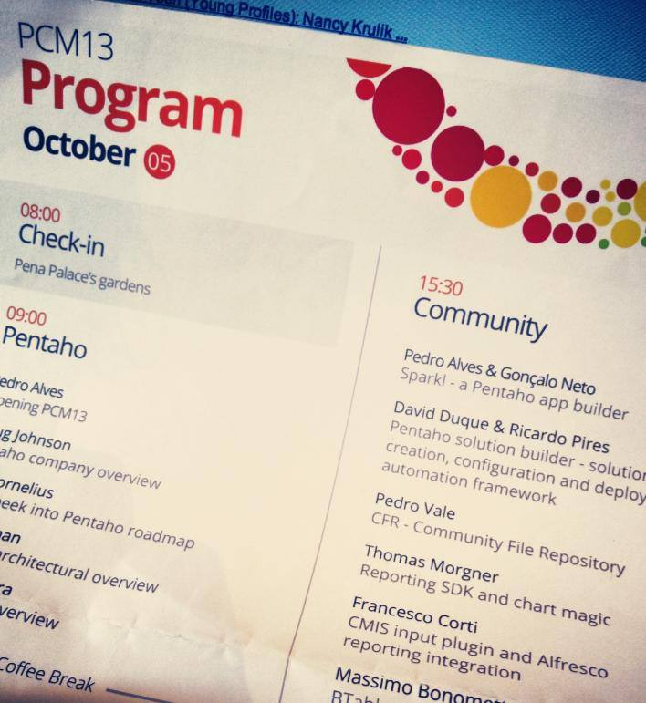


Slide 9
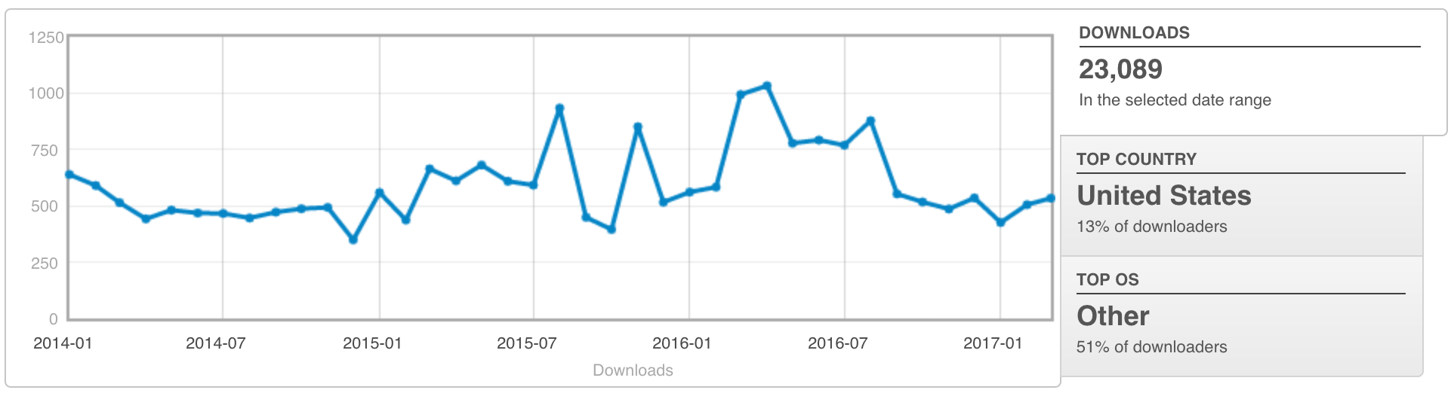

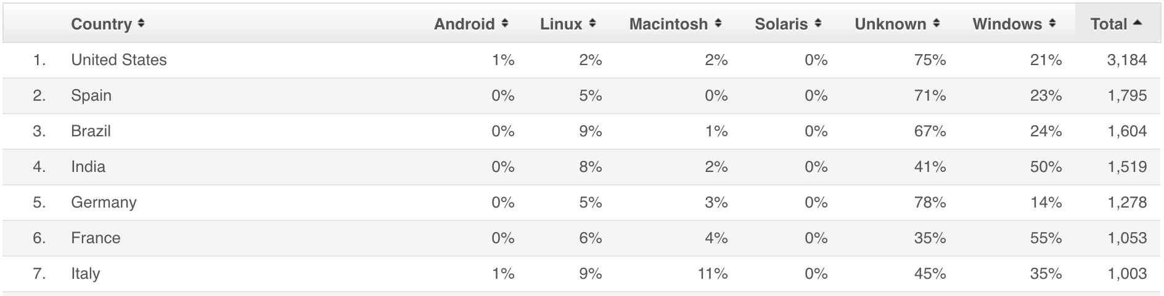

Slide 10

AAAR
is a community project!

Slide 11
?
What is it

Slide 12


Slide 13
1.Audit trail
Who, do, what, when

Slide 14
1.Audit trail
Who, do, what, when
2.Repository
Documents
Folders
Medatada
Custom models

Slide 15
1.Audit trail
Who, do, what, when
2.Repository
Documents
Folders
Medatada
Custom models
3.Processes
Workflows
Tasks
Items

Slide 16
1.Audit trail
Who, do, what, when
1.Reports
Static
2.Repository
Documents
Folders
Medatada
Custom models
3.Processes
Workflows
Tasks
Items

Slide 17
1.Audit trail
Who, do, what, when
1.Reports
Static
2.Repository
Documents
Folders
Medatada
Custom models
2.Dashboards
Interactive
3.Processes
Workflows
Tasks
Items

Slide 18
1.Audit trail
Who, do, what, when
1.Reports
Static
2.Repository
Documents
Folders
Medatada
Custom models
2.Dashboards
Interactive
3.Free analysis
Pivot tables
3.Processes
Workflows
Tasks
Items

Slide 19

1.Audit trail
Who, do, what, when
1.Reports
Static
2.Repository
Documents
Folders
Medatada
Custom models
2.Dashboards
Interactive
3.Free analysis
Pivot tables
3.Processes
Workflows
Tasks
Items

Slide 20
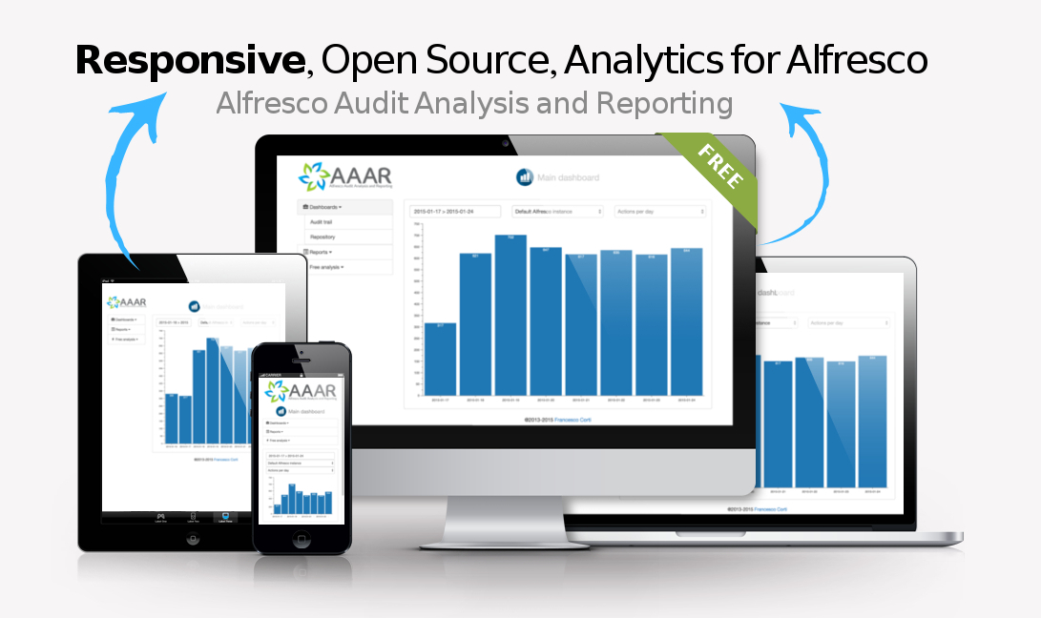

Slide 21
?
Which is the latest version

Slide 22
5
Early Access
Version

Slide 23

5
Early Access
Alflytics
Version

Slide 24
?
Alflytics
How does it work

Slide 25
The Open Source Business Intelligence solution over Alfresco
Alflytics

Slide 26
The typical Business Intelligence architecture
Data Source 1
Data Source 2
Data Source N

Slide 27
The typical Business Intelligence architecture
Data Source 1
Data
Warehouse
/
Lake
Data Source 2
Data Source N

Slide 28
The typical Business Intelligence architecture
Extract Transform Load
Data Source 1
Data
Warehouse
/
Lake
Data Source 2
Data Source N

Slide 29

The typical Business Intelligence architecture
Extract Transform Load
Front-end tools
Data Source 1
Data
Warehouse
/
Lake
Data Source 2
Data Source N
Users

Slide 30
The typical Business Intelligence architecture
Extract Transform Load
Front-end tools
Data Source 1
Reporting
Data
Warehouse
/
Lake
Data Source 2
KPIs
Data Source N
Data mining

Slide 31

Alflytics architecture
Front-end
+
E. T. L.

Slide 32
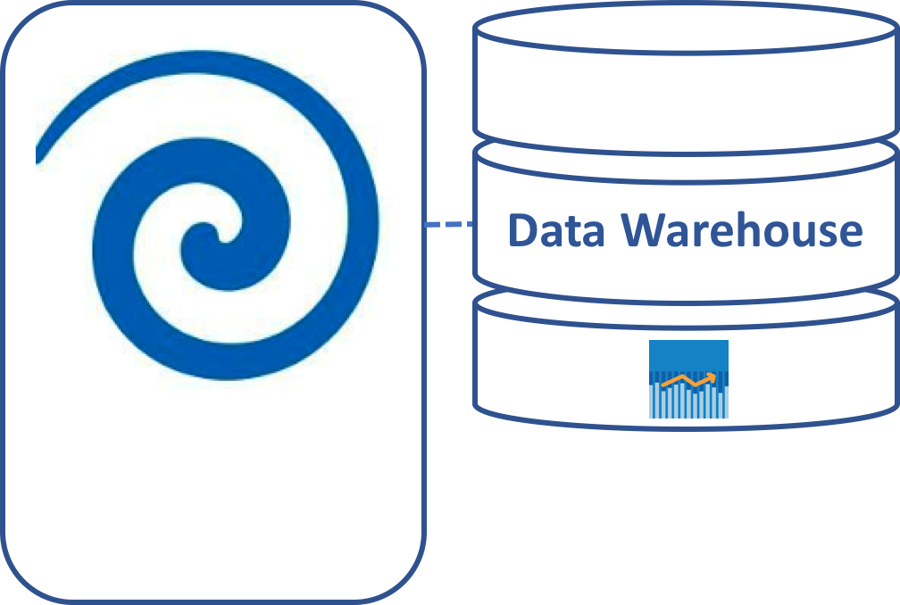
Alflytics architecture
Front-end
+
E. T. L.

Slide 33
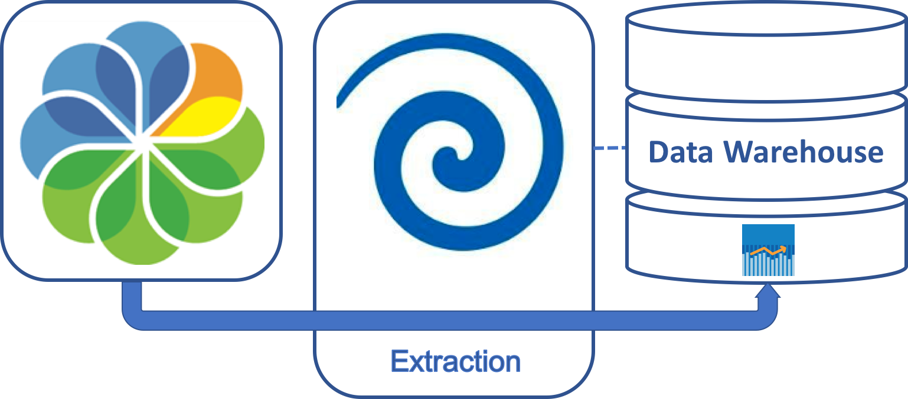
Alflytics architecture

Slide 34
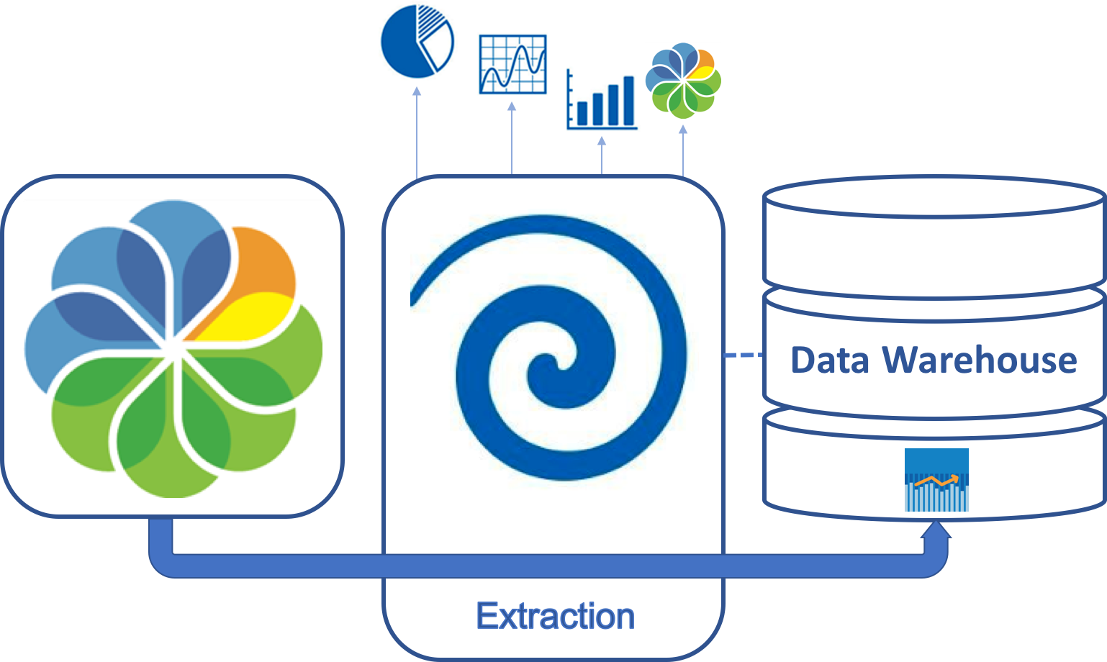
Alflytics architecture

Slide 35
Alflytics architecture
5.2+
7.0

Slide 36



Alflytics architecture
5.2+
7.0

Slide 37
The Open Source Business Intelligence solution over Alfresco
Alflytics
https://github.com/fcorti/Alflytics

Slide 38
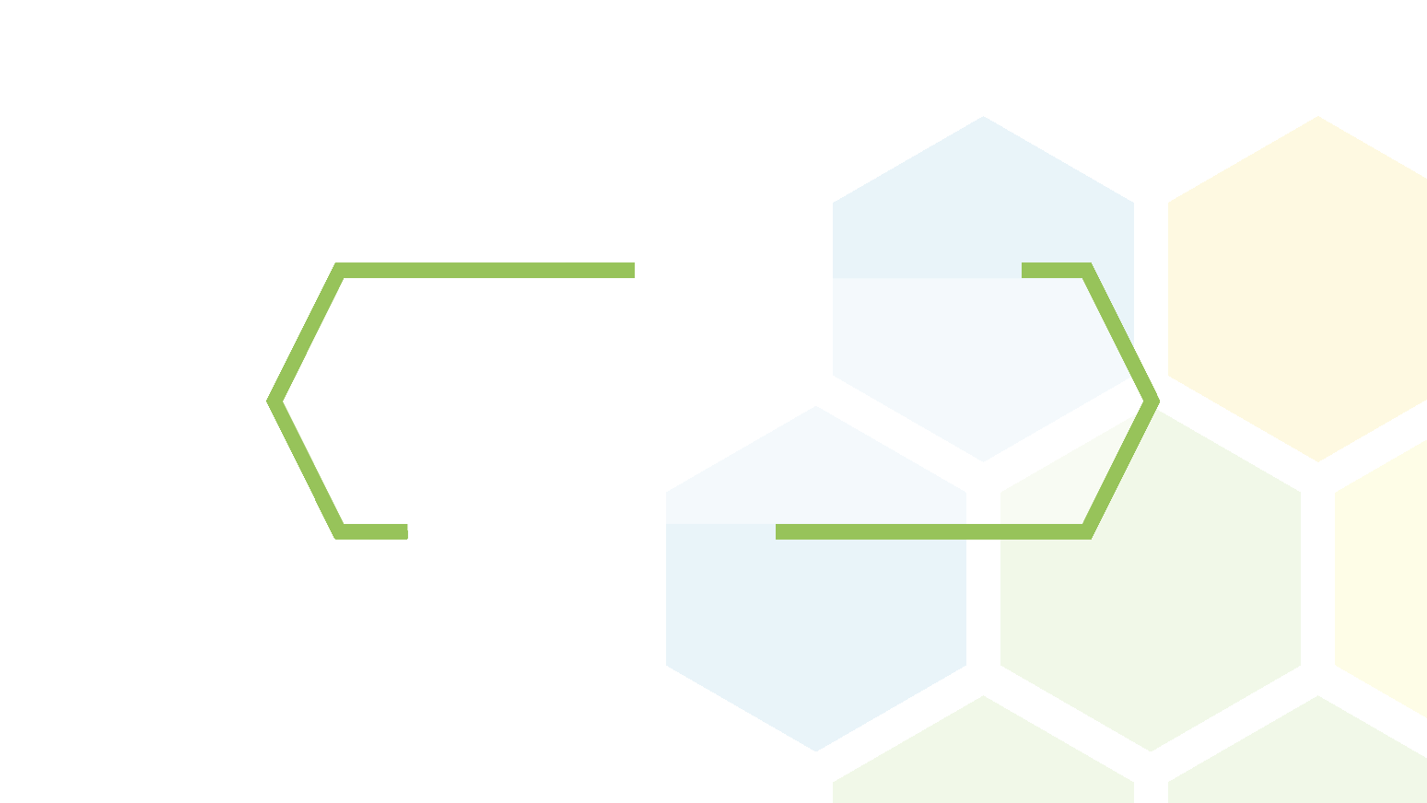
A new dockerized setup ?
How were the new docker images for Alflytics crafted ?

Slide 39

The new setup
Alfresco
5.2+

Slide 40
The new setup
Alfresco
5.2+
Separate Server
VM
….

Slide 41

The new setup
Alfresco
5.2+

Slide 42
The new setup
Alfresco
5.2+
pdubois/docker-alfresco

Slide 43
The new setup
Alfresco
5.2+
services:
alfresco:
image: "pdubois/docker-alfresco:master"
environment:
- INITIAL_PASS=admun
pdubois/docker-alfresco
https://github.com/pdubois/docker-alfresco

Slide 44
The new setup
Alfresco
5.2+
Pentaho BA
7.0

Slide 45
The new setup
Alfresco
5.2+
Pentaho BA
7.0

Slide 46
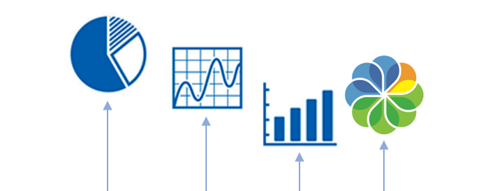

The new setup
Alfresco
5.2+
Pentaho BA
7.0

Slide 47
The new setup
services:
pentaho-alflytics:
image: yreg/docker-alflytics
volumes:
- ./saiku-license.lic:/opt/pentaho/pentaho-server/pentaho-solutions/system/saiku/license.lic
- ./web.xml:/opt/pentaho/pentaho-server/tomcat/webapps/pentaho/WEB-INF/web.xml
- data-alflytics:/opt/pentaho/pentaho-server/data/
- /tmp/.X11-unix:/tmp/.X11-unix
restart: unless-stopped
ports:
- 8080:8080
environment:
- DB_TYPE=hsql
- ALF_VERSION=Alfresco_5_2
- ALF_URL_SCHEME=https
- ALF_URL=alfresco.xenit.eu
- ALF_PORT=443
- ALF_FTP_PATH=alfresco/Reports
- ALF_FTP_PORT=2121
- ALF_USER=Alflytics
- ALF_PASS=53Cre7
hostname: pentaho-alflytics
volumes:
data-alflytics:
Alfresco
5.2+
Pentaho BA
7.0

Slide 48
The new setup
services:
pentaho-alflytics:
image: yreg/docker-alflytics
volumes:
- ./saiku-license.lic:/opt/pentaho/pentaho-server/pentaho-solutions/system/saiku/license.lic
- ./web.xml:/opt/pentaho/pentaho-server/tomcat/webapps/pentaho/WEB-INF/web.xml
- data-alflytics:/opt/pentaho/pentaho-server/data/
- /tmp/.X11-unix:/tmp/.X11-unix
restart: unless-stopped
ports:
- 8080:8080
environment:
- DB_TYPE=hsql
- ALF_VERSION=Alfresco_5_2
- ALF_URL_SCHEME=https
- ALF_URL=alfresco.xenit.eu
- ALF_PORT=443
- ALF_FTP_PATH=alfresco/Reports
- ALF_FTP_PORT=2121
- ALF_USER=Alflytics
- ALF_PASS=53Cre7
hostname: pentaho-alflytics
volumes:
data-alflytics:
Alfresco
5.2+
Pentaho BA
7.0

Slide 49
The new setup
services:
pentaho-alflytics:
image: yreg/docker-alflytics
volumes:
- ./saiku-license.lic:/opt/pentaho/pentaho-server/pentaho-solutions/system/saiku/license.lic
- ./web.xml:/opt/pentaho/pentaho-server/tomcat/webapps/pentaho/WEB-INF/web.xml
- data-alflytics:/opt/pentaho/pentaho-server/data/
- /tmp/.X11-unix:/tmp/.X11-unix
restart: unless-stopped
ports:
- 8080:8080
environment:
- DB_TYPE=hsql
- ALF_VERSION=Alfresco_5_2
- ALF_URL_SCHEME=https
- ALF_URL=alfresco.xenit.eu
- ALF_PORT=443
- ALF_FTP_PATH=alfresco/Reports
- ALF_FTP_PORT=2121
- ALF_USER=Alflytics
- ALF_PASS=53Cre7
hostname: pentaho-alflytics
volumes:
data-alflytics:
Alfresco
5.2+
Pentaho BA
7.0

Slide 50
The new setup
services:
pentaho-alflytics:
image: yreg/docker-alflytics
volumes:
- ./saiku-license.lic:/opt/pentaho/pentaho-server/pentaho-solutions/system/saiku/license.lic
- ./web.xml:/opt/pentaho/pentaho-server/tomcat/webapps/pentaho/WEB-INF/web.xml
- data-alflytics:/opt/pentaho/pentaho-server/data/
- /tmp/.X11-unix:/tmp/.X11-unix
restart: unless-stopped
ports:
- 8080:8080
environment:
- DB_TYPE=hsql
- ALF_VERSION=Alfresco_5_2
- ALF_URL_SCHEME=https
- ALF_URL=alfresco.xenit.eu
- ALF_PORT=443
- ALF_FTP_PATH=alfresco/Reports
- ALF_FTP_PORT=2121
- ALF_USER=Alflytics
- ALF_PASS=53Cre7
hostname: pentaho-alflytics
volumes:
data-alflytics:
Alfresco
5.2+
Pentaho BA
7.0

Slide 51
The new setup
services:
pentaho-alflytics:
image: yreg/docker-alflytics
volumes:
- ./saiku-license.lic:/opt/pentaho/pentaho-server/pentaho-solutions/system/saiku/license.lic
- ./web.xml:/opt/pentaho/pentaho-server/tomcat/webapps/pentaho/WEB-INF/web.xml
- data-alflytics:/opt/pentaho/pentaho-server/data/
- /tmp/.X11-unix:/tmp/.X11-unix
restart: unless-stopped
ports:
- 8080:8080
environment:
- DB_TYPE=hsql
- ALF_VERSION=Alfresco_5_2
- ALF_URL_SCHEME=https
- ALF_URL=alfresco.xenit.eu
- ALF_PORT=443
- ALF_FTP_PATH=alfresco/Reports
- ALF_FTP_PORT=2121
- ALF_USER=Alflytics
- ALF_PASS=53Cre7
hostname: pentaho-alflytics
volumes:
data-alflytics:
Alfresco
5.2+
Pentaho BA
7.0

Slide 52
The new setup
Alfresco
5.2+
Pentaho BA
7.0

Slide 53

The new setup
services:
pentaho-alflytics:
image: yreg/docker-alflytics
volumes:
- ...
restart: unless-stopped
links:
- postgres-alflytics
ports:
- 8080:8080
environment:
- DB_TYPE=postgresql
- DB_PORT=5432
- DB_NAME=pentaho
- DB_HOST=postgres-alflytics
- DB_USERNAME=postgres
- DB_PASSWORD=P@$$w0rd
- ALF_VERSION=Alfresco_5_2
- ALF_URL_SCHEME=https
- ALF_URL=alfresco.xenit.eu
- ALF_PORT=443
- ALF_FTP_PATH=alfresco/Reports
- ALF_FTP_PORT=2121
- ALF_USER=Alflytics
- ALF_PASS=53Cre7
hostname: pentaho-alflytics
postgres-alflytics:
image: postgres:9.4
volumes:
- postgres-alflytics:/var/lib/postgresql/data
ports:
- 127.0.0.2:5432:5432
environment:
- POSTGRES_USER=postgres
- POSTGRES_PASSWORD=P@$$w0rd
restart: unless-stopped
Volumes:
postgres-alflytics:
Alfresco
5.2+
Pentaho BA
7.0

Slide 54
The new setup
services:
pentaho-alflytics:
image: yreg/docker-alflytics
volumes:
- ...
restart: unless-stopped
links:
- postgres-alflytics
ports:
- 8080:8080
environment:
- DB_TYPE=postgresql
- DB_PORT=5432
- DB_NAME=pentaho
- DB_HOST=postgres-alflytics
- DB_USERNAME=postgres
- DB_PASSWORD=P@$$w0rd
- ALF_VERSION=Alfresco_5_2
- ALF_URL_SCHEME=https
- ALF_URL=alfresco.xenit.eu
- ALF_PORT=443
- ALF_FTP_PATH=alfresco/Reports
- ALF_FTP_PORT=2121
- ALF_USER=Alflytics
- ALF_PASS=53Cre7
hostname: pentaho-alflytics
postgres-alflytics:
image: postgres:9.4
volumes:
- postgres-alflytics:/var/lib/postgresql/data
ports:
- 127.0.0.2:5432:5432
environment:
- POSTGRES_USER=postgres
- POSTGRES_PASSWORD=P@$$w0rd
restart: unless-stopped
Volumes:
postgres-alflytics:
Alfresco
5.2+
Pentaho BA
7.0

Slide 55
The new setup
services:
pentaho-alflytics:
image: yreg/docker-alflytics
volumes:
- ...
restart: unless-stopped
links:
- postgres-alflytics
ports:
- 8080:8080
environment:
- DB_TYPE=postgresql
- DB_PORT=5432
- DB_NAME=pentaho
- DB_HOST=postgres-alflytics
- DB_USERNAME=postgres
- DB_PASSWORD=P@$$w0rd
- ALF_VERSION=Alfresco_5_2
- ALF_URL_SCHEME=https
- ALF_URL=alfresco.xenit.eu
- ALF_PORT=443
- ALF_FTP_PATH=alfresco/Reports
- ALF_FTP_PORT=2121
- ALF_USER=Alflytics
- ALF_PASS=53Cre7
hostname: pentaho-alflytics
postgres-alflytics:
image: postgres:9.4
volumes:
- postgres-alflytics:/var/lib/postgresql/data
ports:
- 127.0.0.2:5432:5432
environment:
- POSTGRES_USER=postgres
- POSTGRES_PASSWORD=P@$$w0rd
restart: unless-stopped
Volumes:
postgres-alflytics:
Alfresco
5.2+
Pentaho BA
7.0

Slide 56
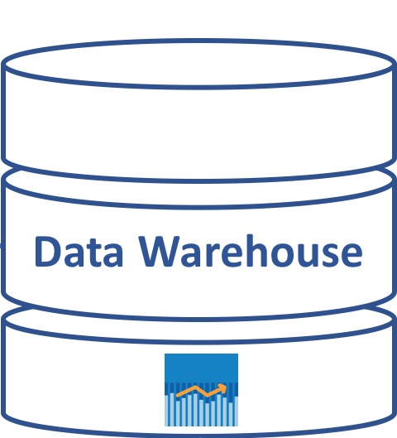
The new setup
Alfresco
5.2+
Pentaho BA
7.0

Slide 57
The new setup
Alfresco
5.2+
Cluster
Pentaho BA
7.0

Slide 58
The new setup
Alfresco
5.2+
Pentaho BA
7.0
Cluster
Pentaho DI
7.0

Slide 59
The new setup
Alfresco
5.2+
Pentaho BA
7.0
Cluster
Cluster
Pentaho DI
7.0
Pentaho DI
7.0

Slide 60
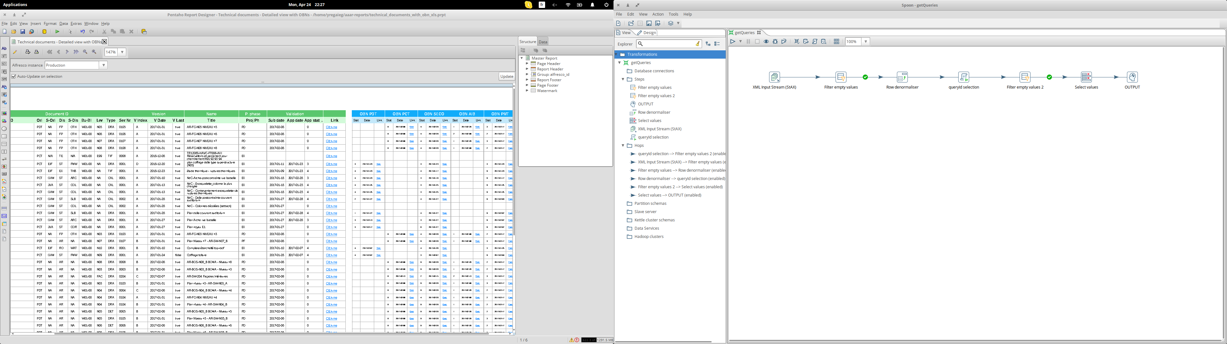
Extending...
$ docker exec -it -e DISPLAY=$DISPLAY dockeralflytics_pentaho-aaar_1 /opt/data-integration/spoon.sh

Slide 61

Where to find it ?
github.com/yregaieg/docker-alfresco
hub.docker.com/r/yregaieg/docker-alfresco

Slide 62
Startup Alflytics in less than 60 seconds ?
(hands on)

Slide 63
Run Pentaho Spoon from docker ?
(hands on)

Slide 64
Run Pentaho Report Designer from docker ?
(hands on)

Slide 65
Play with OLAP cubes structure for free analytics
(hands on)

Slide 66


Thank you! Q&A
Younes Regaieg
y.regaieg@xenit.eu
github.com/yregaieg
@yregaieg
Francesco Corti
fcorti@gmail.com
github.com/fcorti
@FrkCorti

Slide 67
Creative Commons
Slide | Description | Source
#2 | T-Rex by mcdlttx | https://www.flickr.com/photos/mcdlttx/463546162
#4 | Lego developer by Johacim S. Muller | Flickr

